Slide 1
Expecting Mothers Project
Quintessa Calhoun
February 7, 2014
8th period Wills

Slide 2
Purpose of presentation
The purpose of this project is to help pregnant women out. I am doing this project to give pregnant women better things to look at and to do while they are the way that they are. This information that I will give is to help them make great choices and do what they are suppose to be doing while they are with child. This project is to show them the good and bad during pregnancy. The project is to show what you can and can’t do.

Slide 3
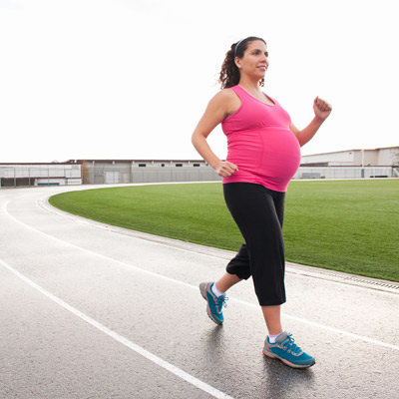
1st Exercise for pregnancy
Walking
One of the best cardiovascular exercises for pregnant women, walking keeps you fit without jarring your knees and ankles. It's also easy to do almost anywhere, doesn't require any equipment beyond a good pair of supportive shoes, and is safe throughout all nine months of pregnancy.

Slide 4
2ND EXERCISE FOR PREGNANCY
Swimming
Healthcare providers and fitness experts hail swimming as the best and safest exercise for pregnant women. Swimming is ideal because it exercises both large muscle groups (arms and legs), provides cardiovascular benefits, and allows expectant women to feel weightless despite the extra pounds of pregnancy

Slide 5
3rd Exercise for pregnancy
Low-impact aerobics
Aerobic exercise strengthens your heart and tones your body. And if you take a class for pregnant women, you'll enjoy the camaraderie of other moms-to-be and feel reassured that each movement is safe for you and your baby.

Slide 6
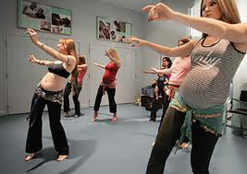
4th exercise for pregnancy
Dancing
You can get your heart pumping by dancing to your favorite tunes in the comfort of your own living room, with a DVD, or at a dance class, but steer clear of routines that call for leaps, jumps, or twirls.

Slide 7
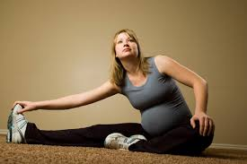
5th Exercise for pregnancy
Stretching
Stretching is wonderful for keeping your body limber and relaxed and preventing muscle strain. Add stretching to your cardiovascular exercises to get a complete workout.

Slide 8
6th exercise for pregnancy
Yoga
Yoga can help maintain muscle tone and keep you flexible with little if any impact on your joints. But you may have to augment a yoga regimen with walking or swimming several times a week to give your heart a workout.

Slide 9
Dietary Guidelines
Whole grains
Enriched, whole-grain breads and cereals are fortified with folic acid and iron and have more fiber than white bread and rice. Work whole grains into your day: oatmeal for breakfast, a sandwich on whole-grain bread at lunch, and whole-wheat pasta or brown rice for dinner.
Beans
Add black beans, white beans, pinto beans, lentils, black-eyed peas, and kidney, garbanzo, or soy beans to your diet. Try them in chili and soups, salads, and pasta dishes. Besides providing protein and fiber, they are also good sources of key nutrients, such as iron, folate, calcium, and zinc.
Salmon
Omega-3 fatty acids are good for your baby's brain and eyes, and salmon is a great source. Plus it provides protein and B vitamins. Salmon is also relatively low in mercury compared to other fish. Try it grilled, broiled, or on a salad. You can safely eat up to 12 ounces of low-mercury fish, such as salmon, per week.
Eggs
Eggs are versatile and a good source of protein that provides amino acids you and your baby need. They contain more than a dozen vitamins and minerals, including choline, which is good for baby's brain development. However, be sure not to eat undercooked or raw eggs.
Berries
Blueberries, raspberries, and blackberries are delicious snacks and taste great in pancakes and on top of cereal. Berries are packed with vitamin C, potassium, folate, and fiber.
Low-fat yogurt
One cup of plain, low-fat yogurt has more calcium than milk, is high in protein, and doesn’t have the added sugar of flavored yogurts. Dress it up with fruit or crunchy, whole-grain cereal.

Slide 10
Appropriate clothing for pregnancy
When you are pregnant, you are suppose to wear better clothes than what you did before. If you were wearing inappropriate clothing such as: holes in the shirt or pants, short clothing, and tight clothing are very inappropriate. When you are pregnant you should wear clothes that are bigger than what you already have at home. You should wear shirts to go over your stomach and loosen pants because it is more comfortable for you and it helps you get around more.

Slide 11
Changes Pregnant women go through
During pregnancy your body goes through tremendous physical changes which most of us tend to overlook. These changes however can make you feel uncomfortable throughout the pregnancy term, and they include how organs such as the heart and lungs function, how your muscles and joints alter and even how your body processes the food you eat. Once you become aware of the mind-boggling changes brought on by pregnancy, you will be motivated to introduce some exercise routine to help you adjust to the new demands that lie ahead.

Slide 12
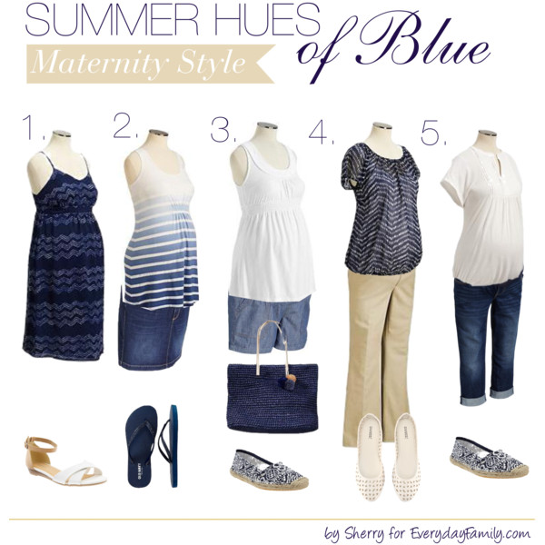
5 days of sample casual outfits

Slide 13
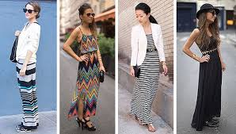
5 days of sample work/professional/business outfits
Dresses would probably be the best clothing to wear to work. It really depends on where you work at though.

Slide 14
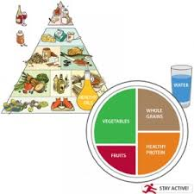
5 days of sample menus for pregnant women
Breakfast
Oatmeal
Slice of Whole Wheat Toast
1/2 Grapefruit
8 oz Glass of Milk (8oz = 1 Cup)
Snack
Blueberry Muffin
Lunch
Broccoli Bacon Quiche
White Bean Salad
Snack
2 Deviled Egg Halves
Dinner
Parmesan Chicken
Rice pilaf
Steamed Carrots
8 oz glass of Milk
Snack
Chocolate Pudding

Slide 15
Different Childbirths
The different types of births were:
water birth
natural birth
C-section
home births

